Slide 1
DATA SCIENCE PROJECT
PROJECT-16 : HR Absenteeism Analytics

Slide 2

DATA SCIENCE PROJECT
PROJECT-16 : HR Absenteeism Analytics

Slide 3
Index
1.Challenge Overview
2.Programming and Insights
3.Tableau Dashboard
4.Personal Insights
5.Conclusions
6.Links

Slide 4
Challenge Overview
Problem Statement : “Increasing employee absenteeism and its impact on productivity: Using data analytics to identify absenteeism patterns and develop targeted interventions for the HR department. This study aims to analyze a dataset of 740 employee records, exploring the associations between absenteeism, age, length of service, and other factors. By applying analytics concepts, we aim to provide actionable insights to enhance workforce management and improve overall organizational efficiency.”
Link: https://drive.google.com/file/d/1ovi_OP7qzGuaqB43oC-FDBMURPUtUGoG/view?usp=drive_link

Slide 5
PROGRAMMING AND INSIGHTS
I was given a dataset regarding the details of employees in the company to make sure the dataset is consistent , I had to go through some steps that are listed below :-
Analysing data to get basic information
Data Cleaning and Statistical Operations
Data Visualization

Slide 6
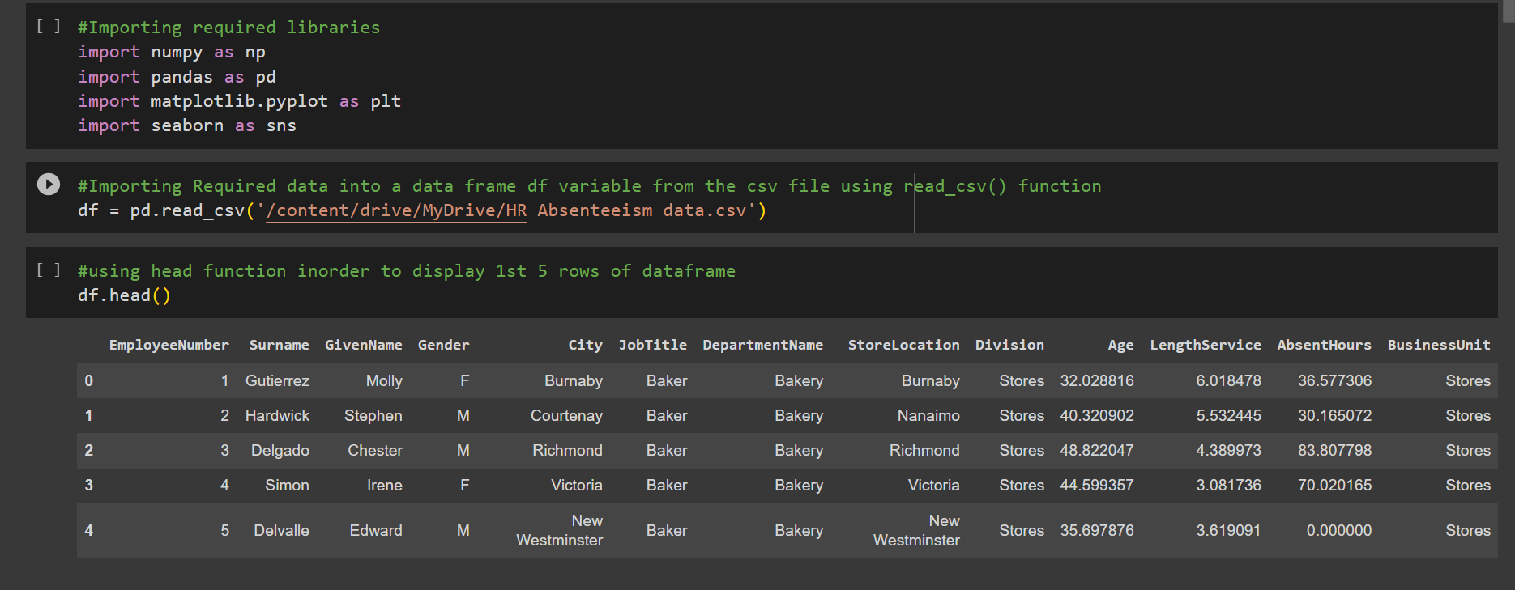
A. Analyzing data to get basic information
To get Basic info about data in dataset import needed python libraries then Excel file using pandas inbuilt functions.
Functions like head(),info(),dtype(),len()..,etc.
Here’s the screenshot

Slide 7
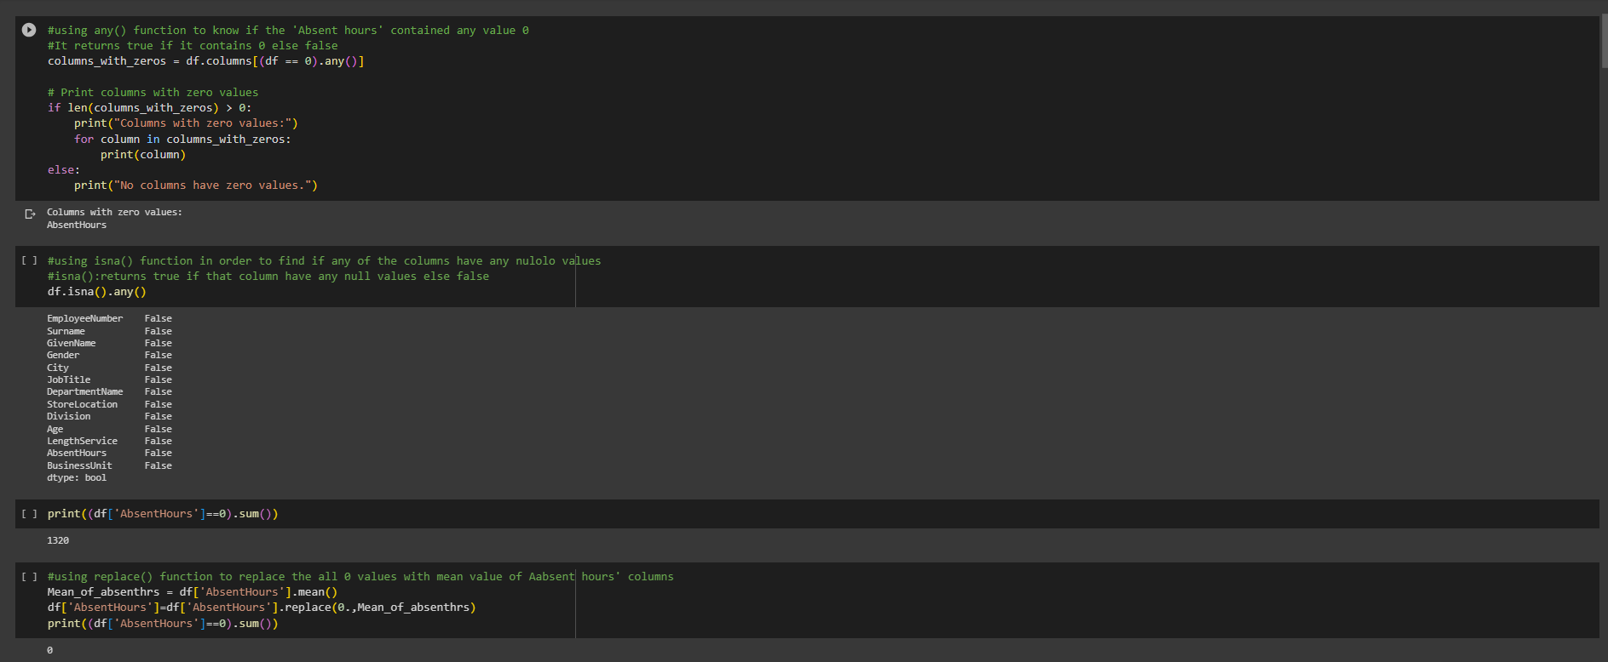
B. Data Cleaning and Statistical Operations
Data set contains anomalies to make it consistent and clean some operations should be done like inserting mean values in place of 0’s or null values.
Functions like isnull(),some conditional statements are used to know if there are nay null or 0 values.

Slide 8
C. Data Visualization
There are dependent and independent columns in given dataset , using them we can visualize the relation between them so that one can draw conclusion
Dependent variable is Absent hours and independent variables are LengthService,EmployeeNumber,Age.
Graphs used are :
Histogram
Barplot
Counterplot
Scatterplot

Slide 9
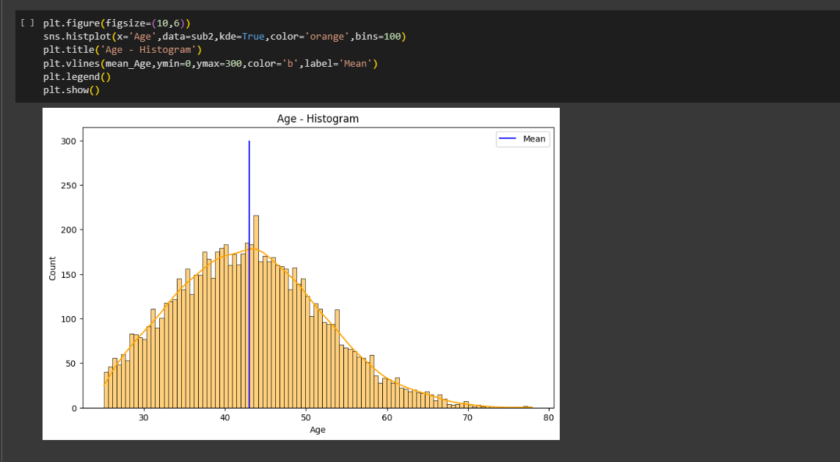
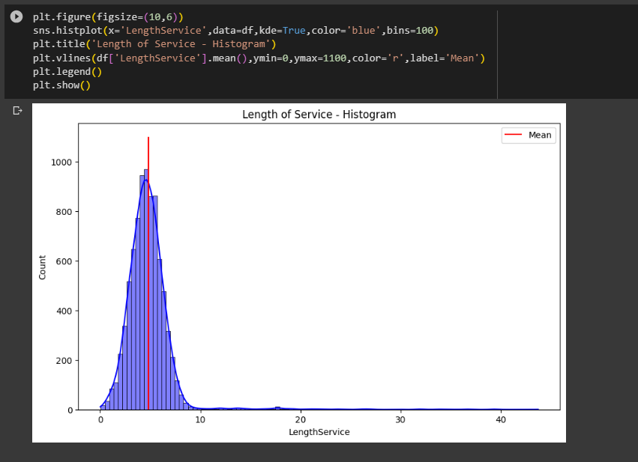
Histogram:

Slide 10
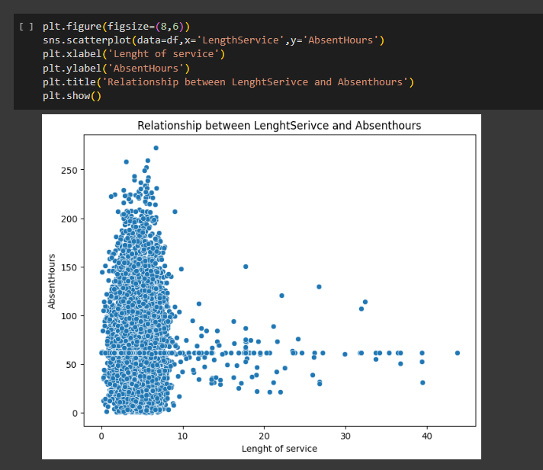
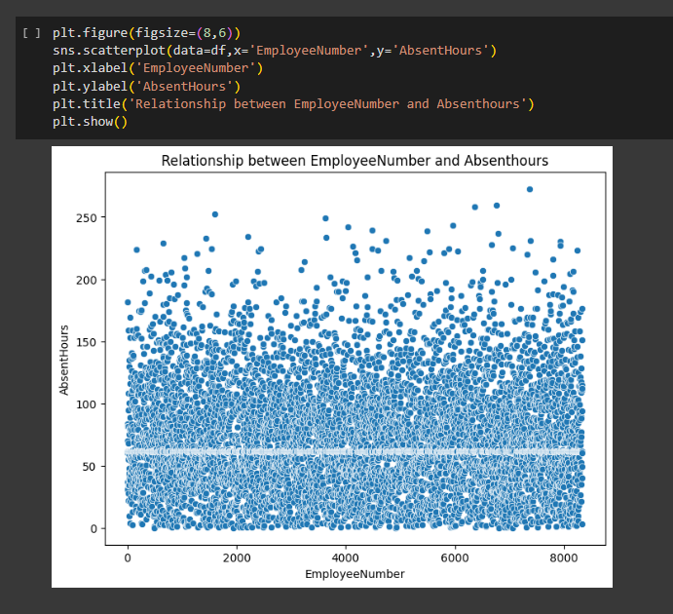
Scatterplot:

Slide 11
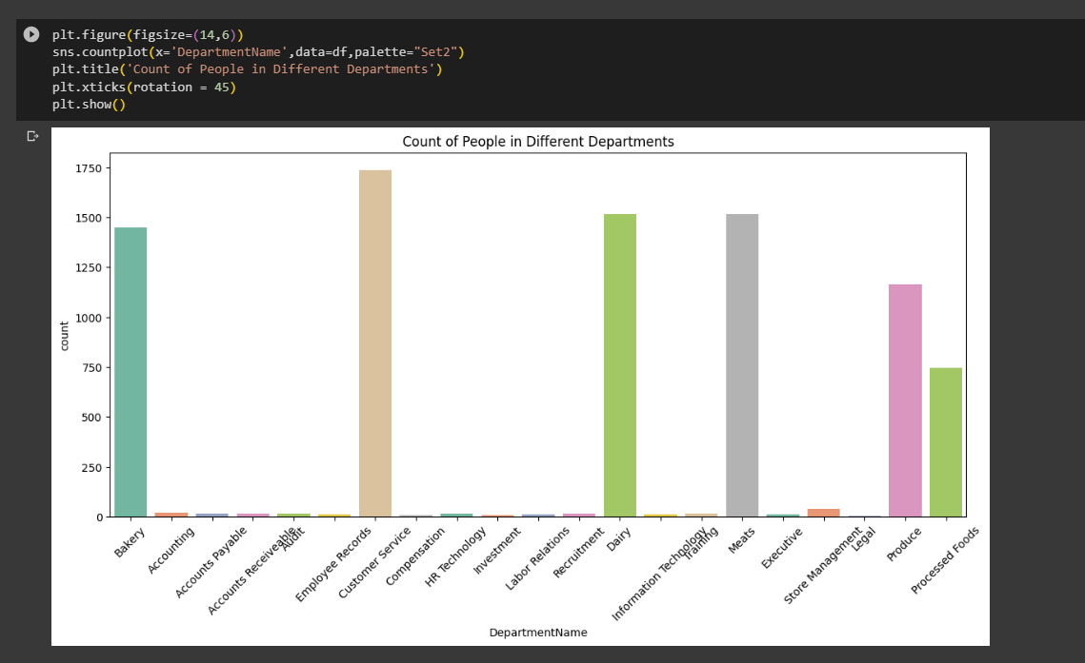
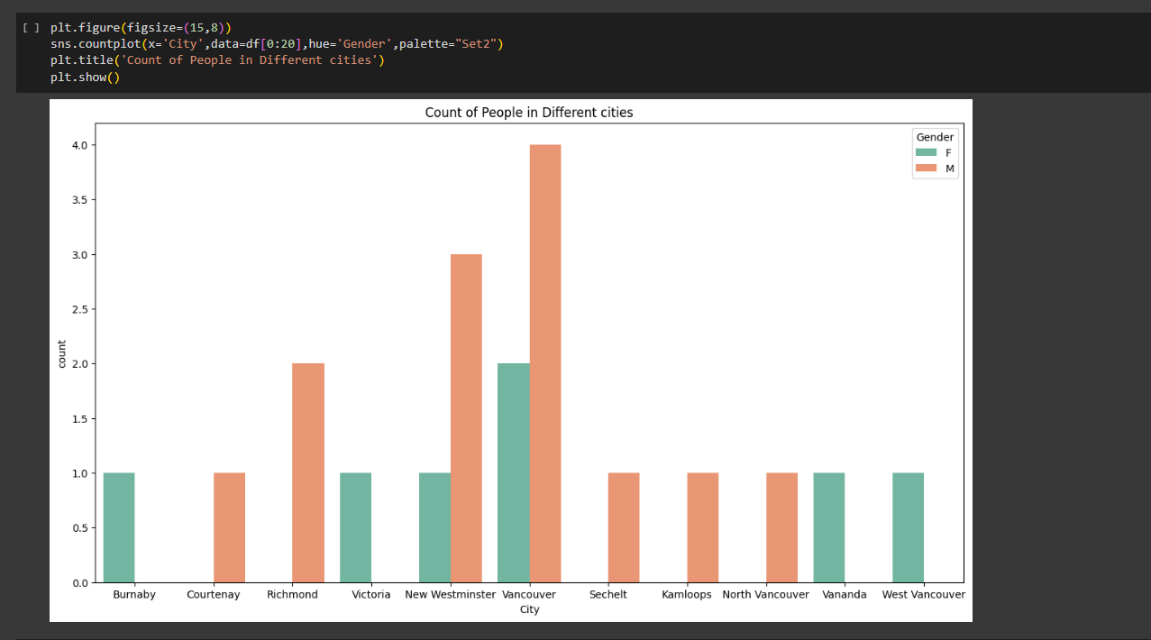
Countplot

Slide 12
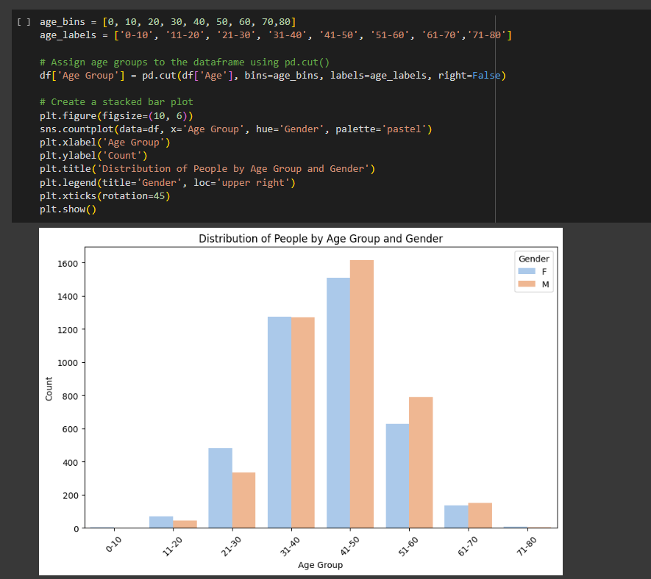
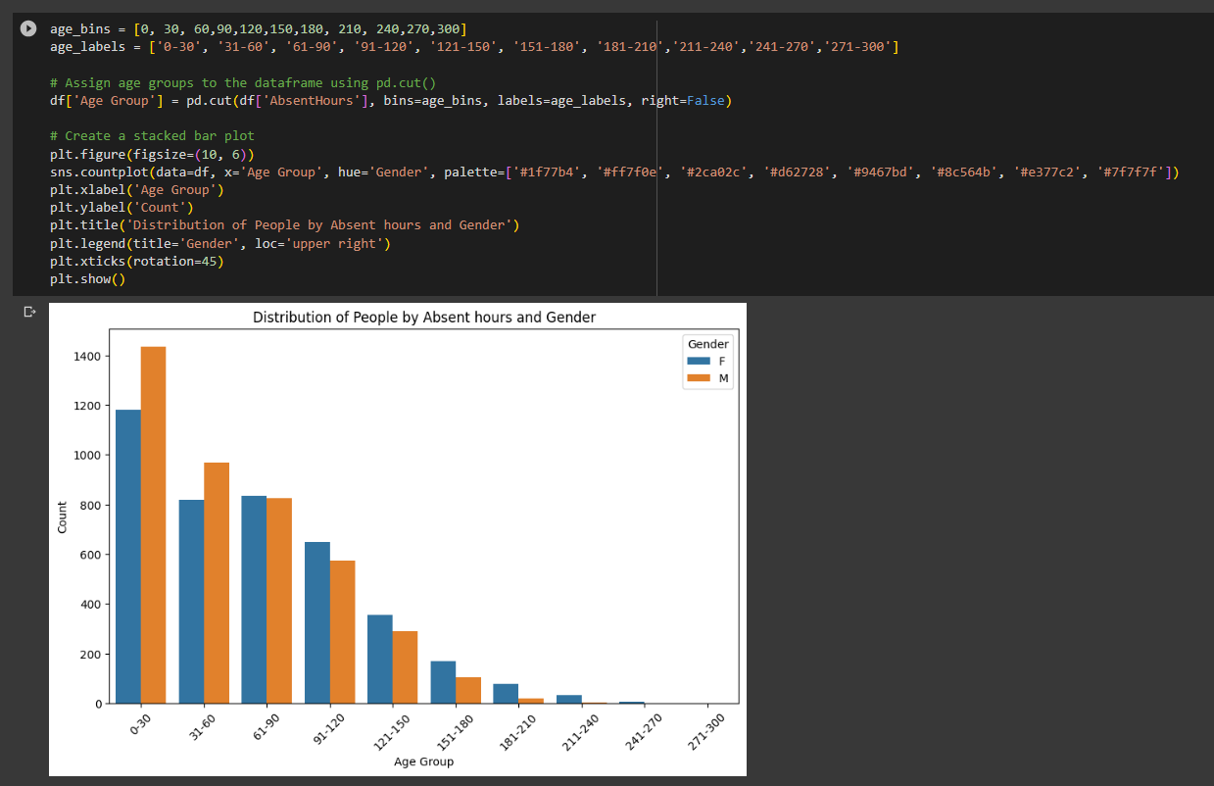
Barplot :

Slide 13
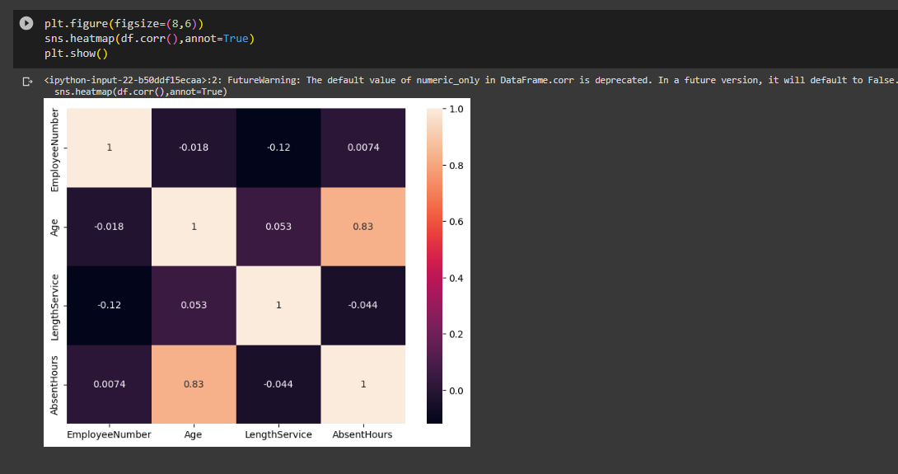
Heatmap:

Slide 14
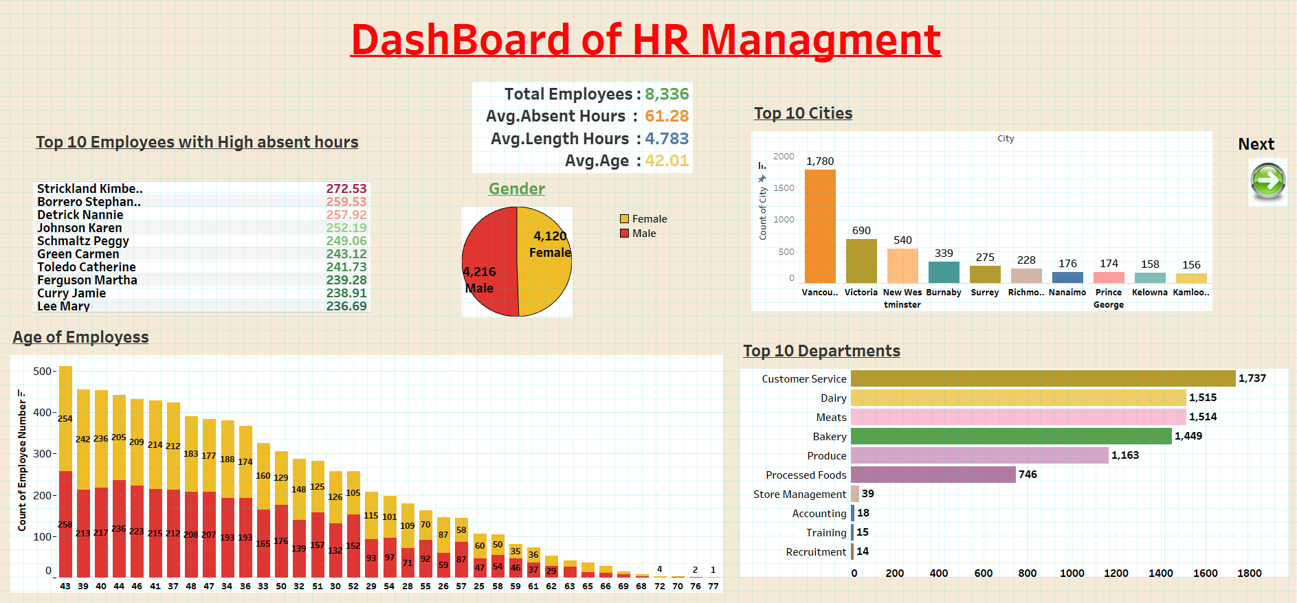
Tableau Dashboard :

Slide 15
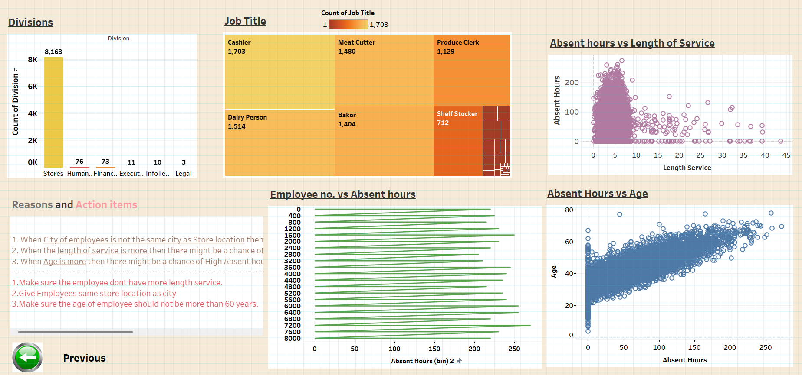

Slide 16
Personal Insights
When City of employees is not the same city as Store location then there might be a chance of high absent hours among employees.
When the length of service is more then there might be a chance of High Absent hours
When Age is more then there might be a chance of High Absent hours
Make sure the employee dont have more length service.
Give Employees same store location as city
Make sure the age of employee should not be more than 60 years.

Slide 17
Conclusion
The dataset containing Employee data is visualized by using various methods and know findings from it.
Most of the employees take leaves due to more length of service , so it is ought to give them frequent breaks and holidays in weekends.
Mostly appoint employees with same store location and city name.
Take in Emplyees with age greater than 24.
Make sure female employees don’t have more length of service.
The dataset containing Employee data shows that employee Absent hours does depend on other factors like length of service and Age
The correlation between age and Absent hours is 0.6790913056408363.
The correlation between Length Service and Absent hours is
-0.02352242282285967.

Slide 18
Links: Tableau : https://public.tableau.com/views/Book1_16904718438610/Dashboard1?:language=en-US&publish=yes&:display_count=n&:origin=viz_share_link Colab Notebook : https://colab.research.google.com/drive/18xdl0Rf-iK0XJw9gLF6-FbCEVUzhalKQ

Slide 19
Thank You

